Slide 1

By Pulkit Goel

Slide 2
Introduction
Purpose:
To explore the factors leading to
bank account closures using insights
from a Kaggle dataset.
Why It Matters:
Understanding customer behavior helps
improve Retention strategies and optimize services.
Overview:
Dataset description, methodology,
analysis, and insights.

Slide 3

Dataset Overview
Data Sources:
Utilized a public dataset from Kaggle.
Key Variables:
Age
Account Balance
Account Status (Closed/Open)
Country
Credit Score

Slide 4
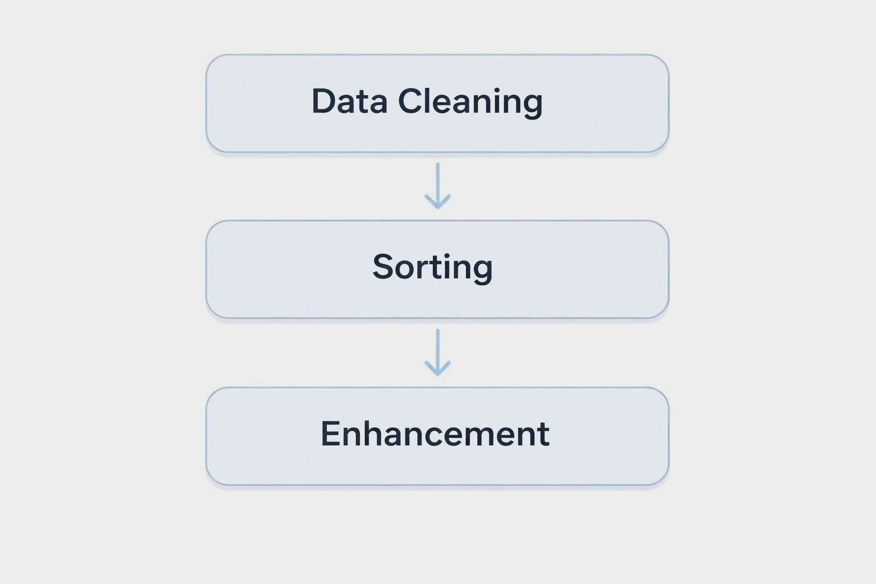
Data Preparation
Cleaning:
Removed duplicates and handled
missing values.
Sorting:
Sorted data based on balance and
salary for easier analysis.
Enhancements:
Added necessary rows and columns
for detailed analysis.

Slide 5
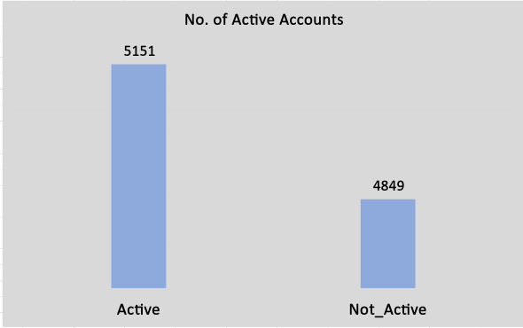
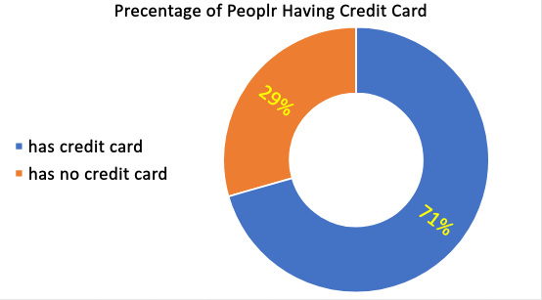
Data Overview
Total No. of Accounts
10,000
( 15565701 to 15815690 )

Slide 6
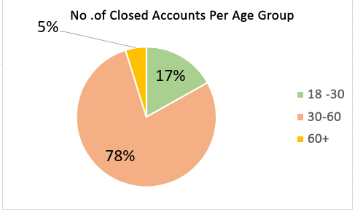
Insight 1 ( Age Group )
Key Observation:
From the provided pie chart, 78% of
account holders who closed
their accounts belong to the
30-60 age group.
Implications:
This significant percentage
suggests that this demographic
might be facing issues or changes in their financial needs or satisfaction with the services offered.

Slide 7
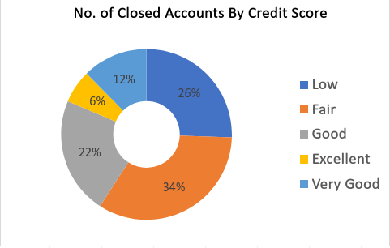
Insight 2 ( Credit Score )
Key Observation:
The doughnut chart illustrates that 34% of
account holders who closed their accounts
fall within the fair credit score range.
Insights:
The high percentage of account closures
among individuals with fair and low
Credit scores may indicate a fear of
worsening their credit situation.
It suggests that these individuals might be concerned about the impact of account
closure on their credit profiles.

Slide 8
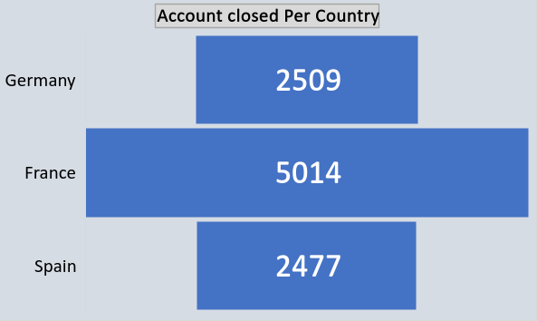
Insight 3 ( Geographic Distribution )
Key Observation:
The chart reveals that nearly
50% of account holders who
closed their accounts are
based in France.
Implications:
This significant concentration
suggests potential issues
related to accessibility, such as
a lack of branches or insufficient services tailored to the needs of customers in that region.

Slide 9
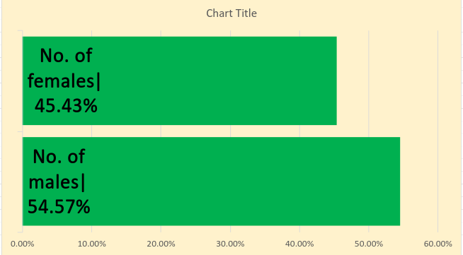
Insight 4
Key Observation:
The chart indicates that 54.5%
of account holders who closed
their accounts are male.
Implications:
Understanding the motivations
behind these closures could be crucial for tailoring targeted retention
strategies, such as tailored communication, promotions, or services that resonate more with male customers.

Slide 10
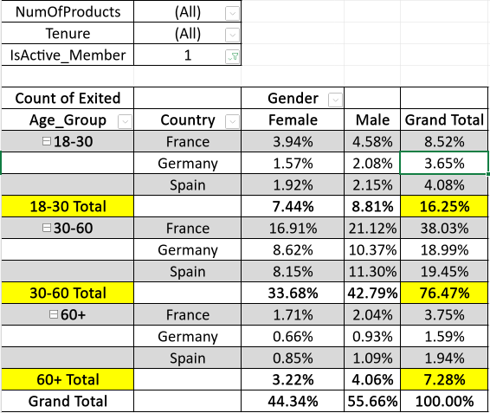
Final Insight
Key Observation :
The given pivot table shows that the most
Account holders who closed their
Account belonged to age group of
30 -60 and are based in France,
Which is 38.03%.
Out of which, 21.12% are males
Who are also are a majority of
Account droppers.
Implications:
This suggests that the male of locations
,like France, are not Financially strong
and are facing issues like low credit score, leading to closing their Bank Account .

Slide 11

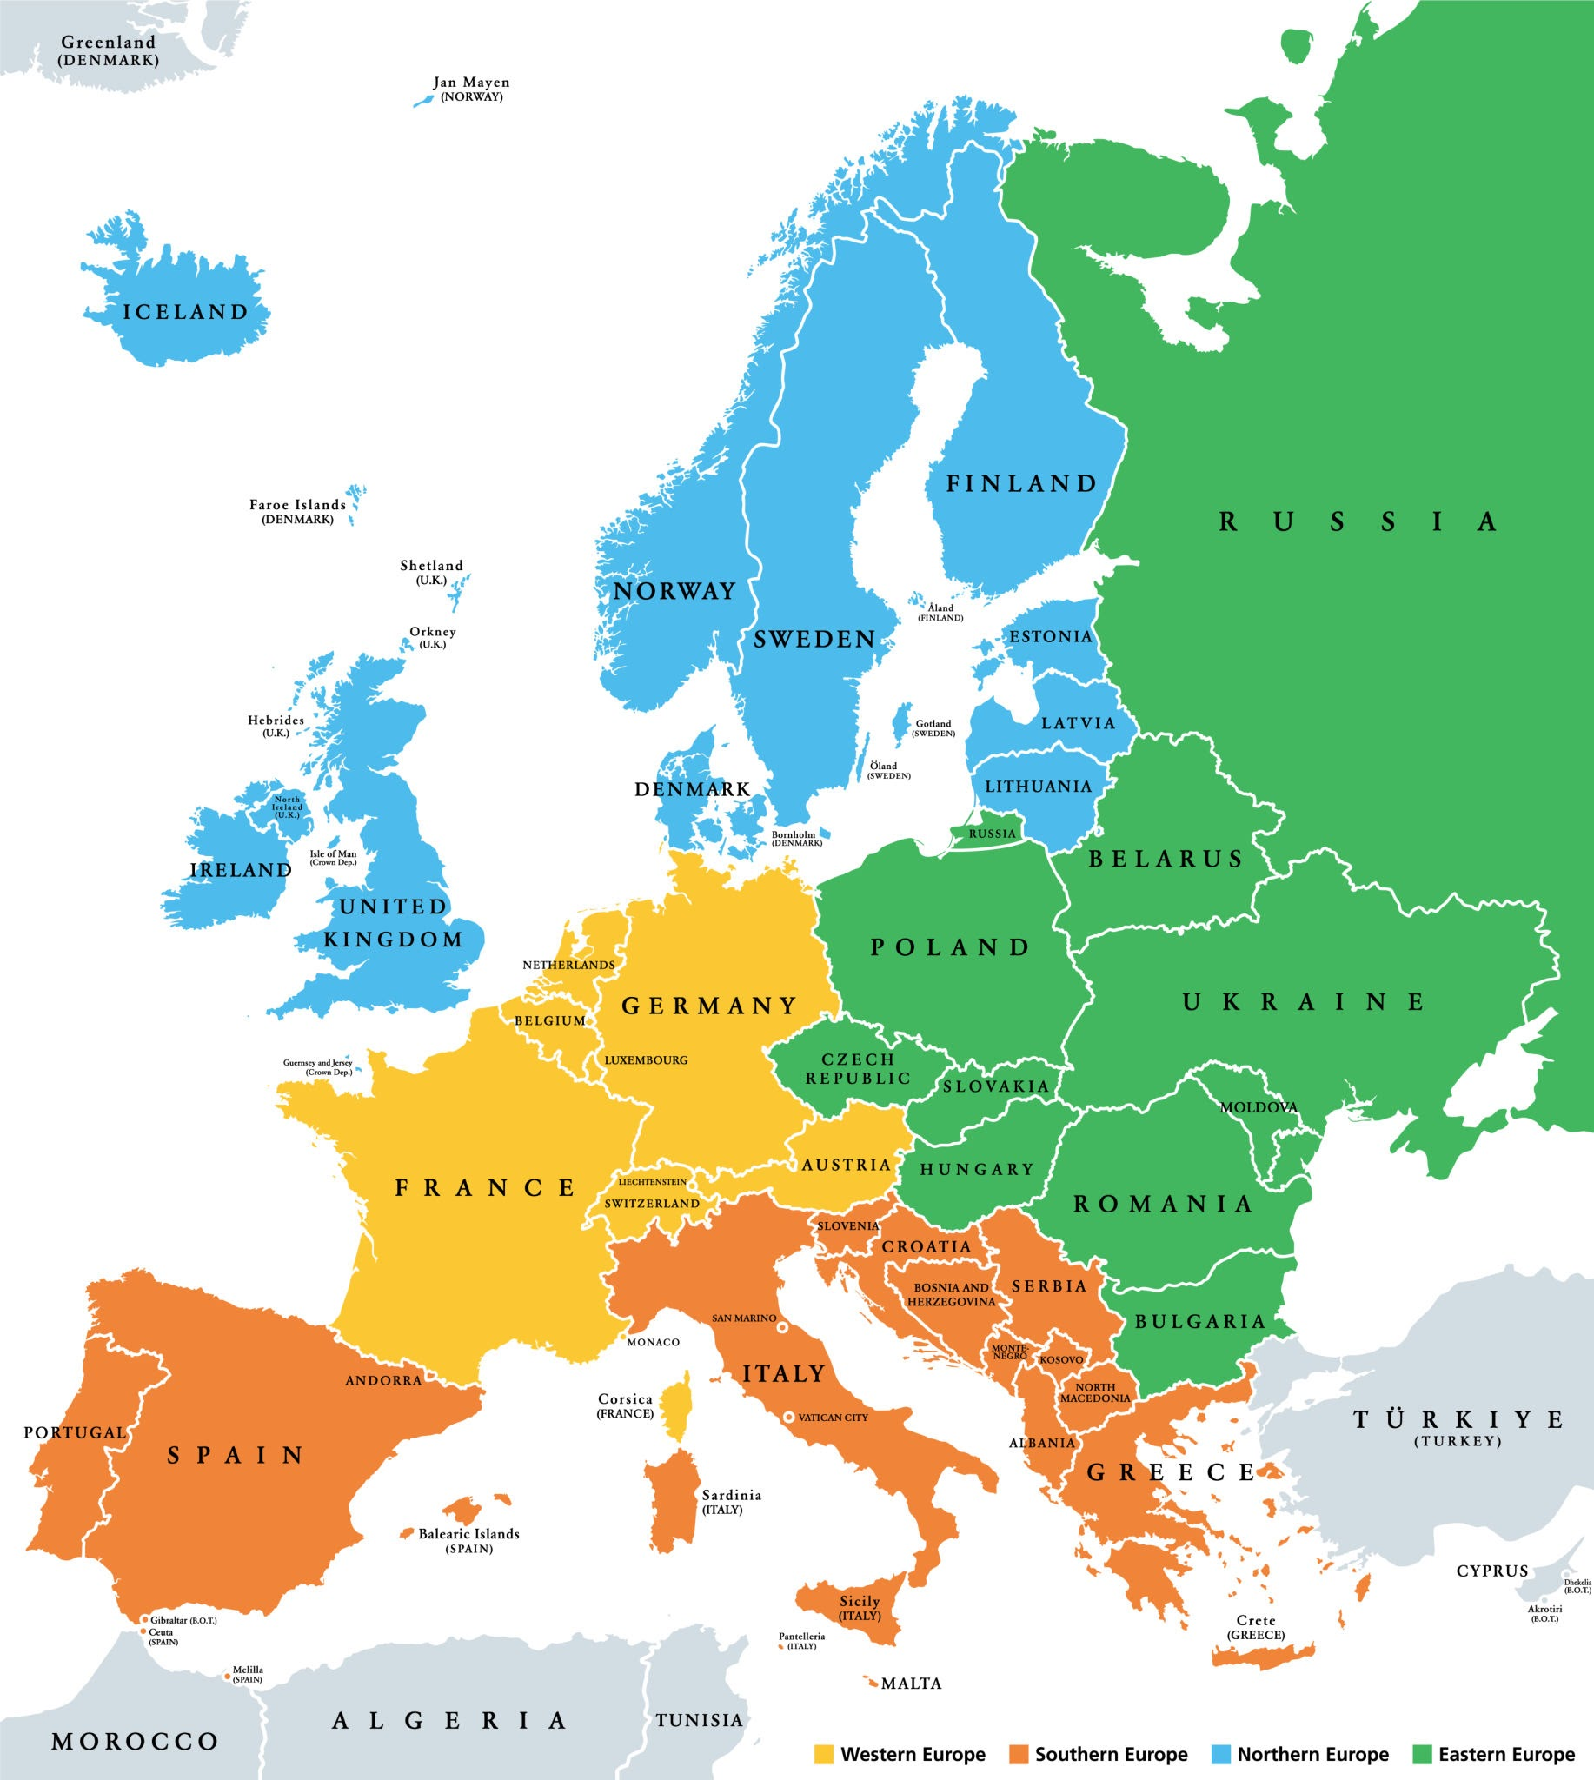
Recommendations Based on Insights
Given these insights, our recommendations aim to
address the root causes of account closures and
foster long-term customer loyalty:
Targeted Engagement for Male Customers:
Develop marketing and communication
strategies that specifically address the
interests and concerns of male
customers based on their needs and preferences.
Geographic Expansion:
Consider expanding branch availability in regions with high closure rates, particularly in France, to improve accessibility and personalized service.

Slide 12

Educational Programs on Credit Management:
Implement initiatives
that educate customers
about managing their
credit and financial health,
alleviating fears
associated with
account closures.
Feedback Mechanisms:
Establish channels for receiving feedback from customers who close their accounts to continuously refine service offerings and address concerns proactively.

Slide 13
Thank You
By Pulkit Goel
LinkedIn - linkedin.com/in/pulkit-goel-753925403
GitHub - github.com/pulkitgoel666

